Slide 1
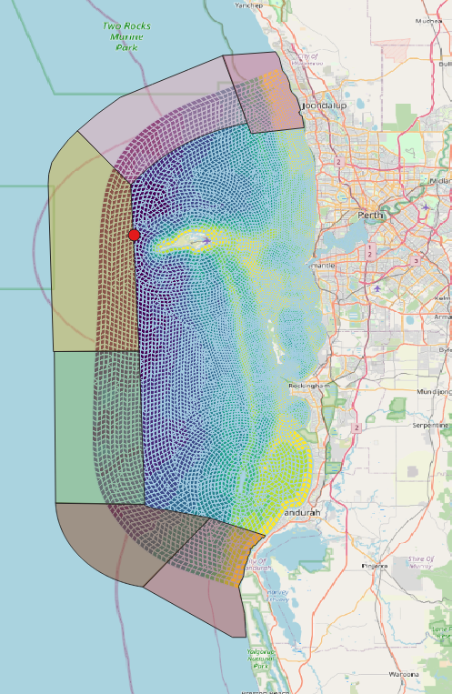

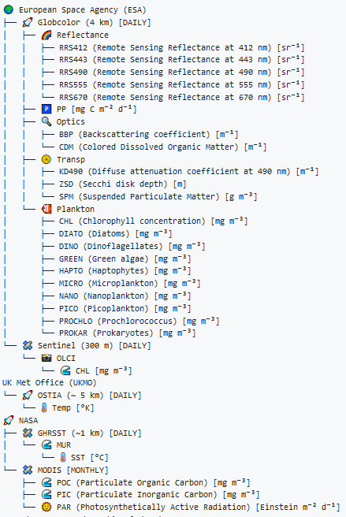


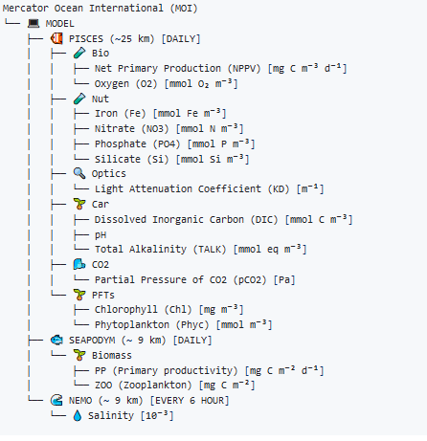
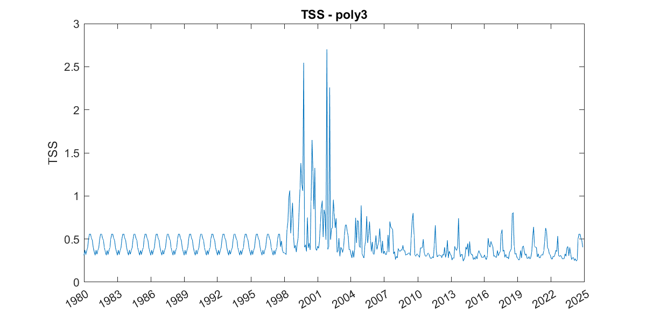
Remote sensing
CSIEM ocean BGC boundary condition settings
Nearshore and offshore boundary polygons
Remote sensing datasets
Global ocean model
IMOS
In-situ measurements
Global ocean BGC
model datasets
IMOS datasets
Example resulting TSS boundary condition
IMO-ANMN
Temp
Salinity
DO
Turbidity
IMOS-BGC
Salinity
DO
DIC
AMM
NIT
FRP
TSS …
Combined BCs
Monthly-mean BCs

Slide 2
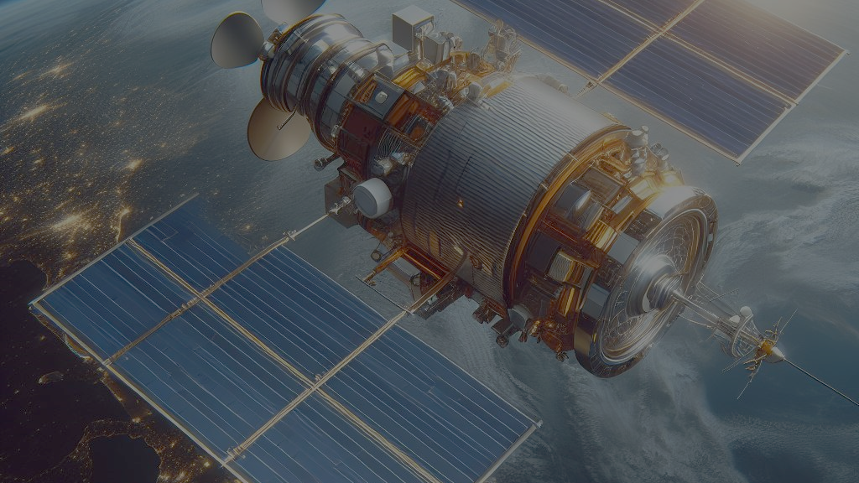
Satellite and Model dataset, folder hierarchy in s3 bucket
Md Rony Golder
Data Analyst,
WAMSI

Slide 3

Data Lake
CMEMS
GLOBCOLOR
GHRSST
MUR
Sentinel
MODEL
OLCI
PISCES
NASA
Reflectance
PP
Optics
Transp
Plankton
OSTIA
Temp
SST
CHL
MODIS
POC
PIC
PAR
SEAPODYM
Biomass (PP, ZOO)
Bio
Nut
Optics
Car
Co2
PFTs
NEMO
Salinity

Slide 4
CMEMS GLOBCOLOR Dataset Overview
Category | Variables | Total
Reflectance | RRS412, RRS443, RRS490, RRS555, RRS670 | 5
Primary Production (PP) | PP (Primary Production) | 1
Optical Properties | BBP (Backscattering coefficient), CDM (Colored Dissolved Organic Matter) | 2
Transparency | KD490 (Diffuse attenuation coefficient at 490 nm), ZSD (Secchi disk depth), SPM (Suspended Particulate Matter) | 3
Plankton | CHL (Chlorophyll concentration), DIATO (Diatoms), DINO (Dinoflagellates), GREEN (Green algae), HAPTO (Haptophytes), MICRO (Microplankton), NANO (Nanoplankton), PICO (Picoplankton), PROCHLO (Prochlorococcus), PROKAR (Prokaryotes) | 10
Data Sources:
SeaWiFS, MODIS, MERIS, VIIRS-SNPP & JPSS1, OLCI-S3A & S3B
Data Frequency: Daily
Spatial Resolutions:
4 km
Temporal Resolutions: 4 Sep 1997 to Present

Slide 5
Sentinel OLCI Data overview
Category | Sentinel OLCI Data
Data Sources | OLCI-S3A & S3B
Data Frequency | Daily
Spatial Resolutions | 300m
Temporal Resolutions | 25/04/2016 to Present
Variables | Chlorophyll a in sea water (CHL) [mg/m³]

Slide 6
NASA MODIS Dataset Overview
Category | Details
Data Sources | MODIS
Spatial Resolutions | 4 km
Data Frequency | Monthly
Temporal Resolutions | 2002-07-04 to Present
Variables | Particulate Organic Carbon (POC), Photosynthetically Active Radiation (PAR), Particulate Organic Carbon (POC)

Slide 7
CMEMS OSTIA Dataset and the GHRSST MUR Dataset
Category | CMEMS OSTIA Dataset | GHRSST MUR Dataset
Data Sources | Satellite | Satellite
Data Frequency | Daily | Daily
Spatial Resolutions | 0.05° | 1 Km
Temporal Resolutions | 1 Oct 1981 to Present | 2002-05-31 to Present
Variables | Analysed Sea Surface Temperature (analysed_sst) [K] | Analysed Sea Surface Temperature (analysed_sst) [°C]

Slide 8
MODEL Data overview
Category | Variables | Total
Bio | Net Primary Production (nppv), Oxygen (o2) | 2
Nut | Iron (fe), Nitrate (no3), Phosphate (po4), Silicate (si) | 4
Optics | Light Attenuation Coefficient (kd), Phytoplankton (phyc) | 2
Car | Dissolved Inorganic Carbon (dissic), pH, Total Alkalinity (talk) | 3
CO2 | Partial Pressure of CO2 (spco2) | 1
PFTs | Chlorophyll (chl), Phytoplankton (phyc) | 2
Data Sources:
PISCES- Model
Data Frequency: Daily
Spatial Resolutions: 0.25 deg
Temporal Resolutions: 01/11/2021 to Present

Slide 9
MODEL Data overview
Category | BGC | PHY
Data Sources | SEAPODYM | NEMO
Data Frequency | Daily | Daily
Spatial Resolutions | 0.083° | 0.083°
Temporal Resolutions | 1 Jan 1998 to Present | 1 Nov 2020 to Present
Variables | Mass content of zooplankton expressed as carbon in sea water (zooc), Net primary productivity of biomass expressed as carbon in sea water (pp) | Sea water salinity (s)

